Slide 1

SENTIMENT ANALYSIS Of AMAZON FOOD REVIEWS

Slide 2
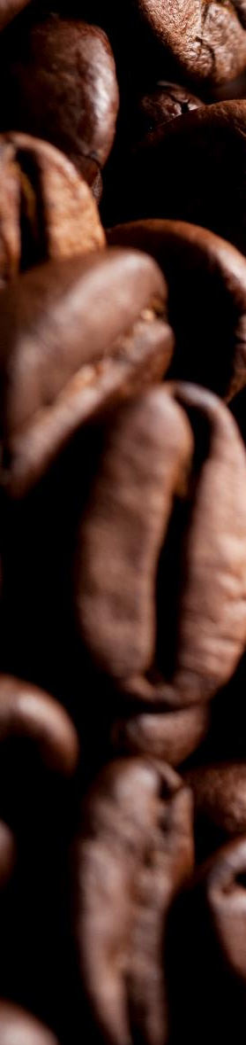
01
OBJECTIVE
02
PROJECT OVERVIEW
03
DATA ANALYSIS
04
DATA PREPROCESSING
05
MODEL BUILDING
06
CONCLUSION

Slide 3
01
OBJECTIVE
The key objective of this project is to analyze the sentiment of customers that are reviewing food products on amazon.com
This project is divided into two parts:
In Part 1 lexicon-based approach is used to gather insights on different types of sentiments experienced by customers
In Part 2 using score as target value a supervised machine learning model is built that can predict customers sentiment based on textual review.
The analysis done in this project would enable the organization to take strategic decisions based on their customers sentiments

Slide 4
02
PROJECT OVERVIEW
Below illustration shows the approach followed in this project
Analyze the overall sentiment of reviews
Preprocess data to build document term matrix
The dataset is obtained from Kaggle.com as an .sqlite file
Final insights and conclusion
Choose a sentiment lexicon to predict sentiments
Diving train and test data for sentiment prediction
Checking the accuracy of sentiment prediction models
Did exploratory data analysis to check any data issues

Slide 5
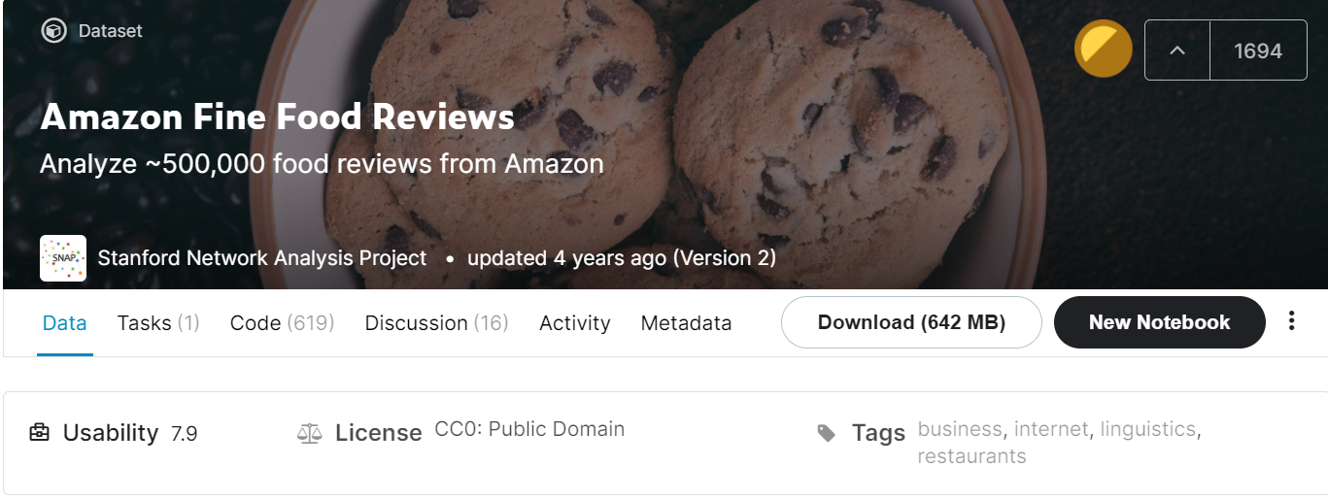
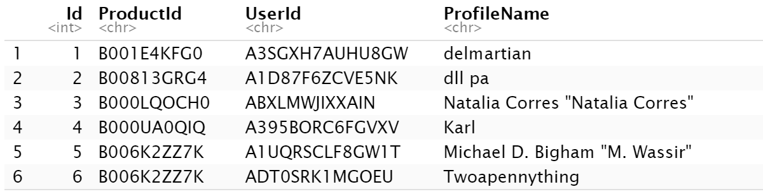
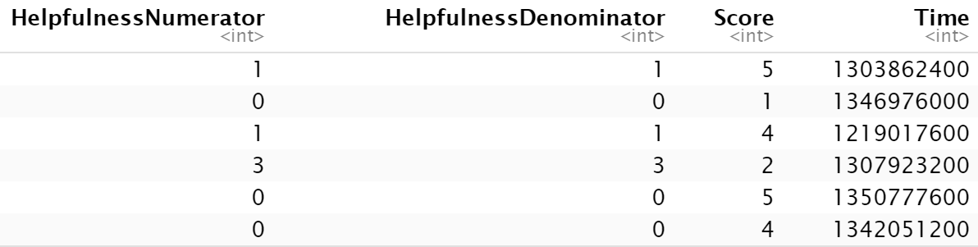
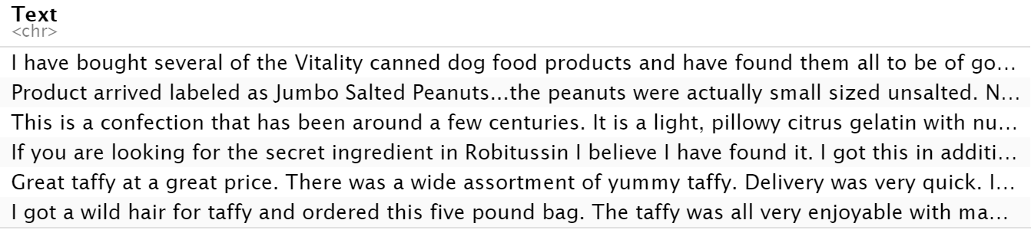
03
DATA ANALYSIS
About the data
The amazon food review data has below attributes:
Id
ProductId - unique identifier for the product
UserId - unique identifier for the user
Profile Name
Helpfulness Numerator - number of users who found the review helpful
Helpfulness Denominator - number of users who indicated whether they found the review helpful or not
Score - rating between 1 and 5
Time - timestamp for the review
Summary - brief summary of the review
Text - text of the review
Original Dimension of Data
~ 500,000 observations (rows)
10 attributes (columns)
Source: https://www.kaggle.com/snap/amazon-fine-food-reviews

Slide 6
03
DATA ANALYSIS
Selecting required data
For the analysis of customer sentiment, I have selected a part of the dataset that has products that get more than 3 reviews and only one review from each of the popular product is used for analysis
Data Issues:
Few exactly same reviews made by same customer at a particular time were observed. These records need to be removed as they would not be useful for analysis.

Slide 7
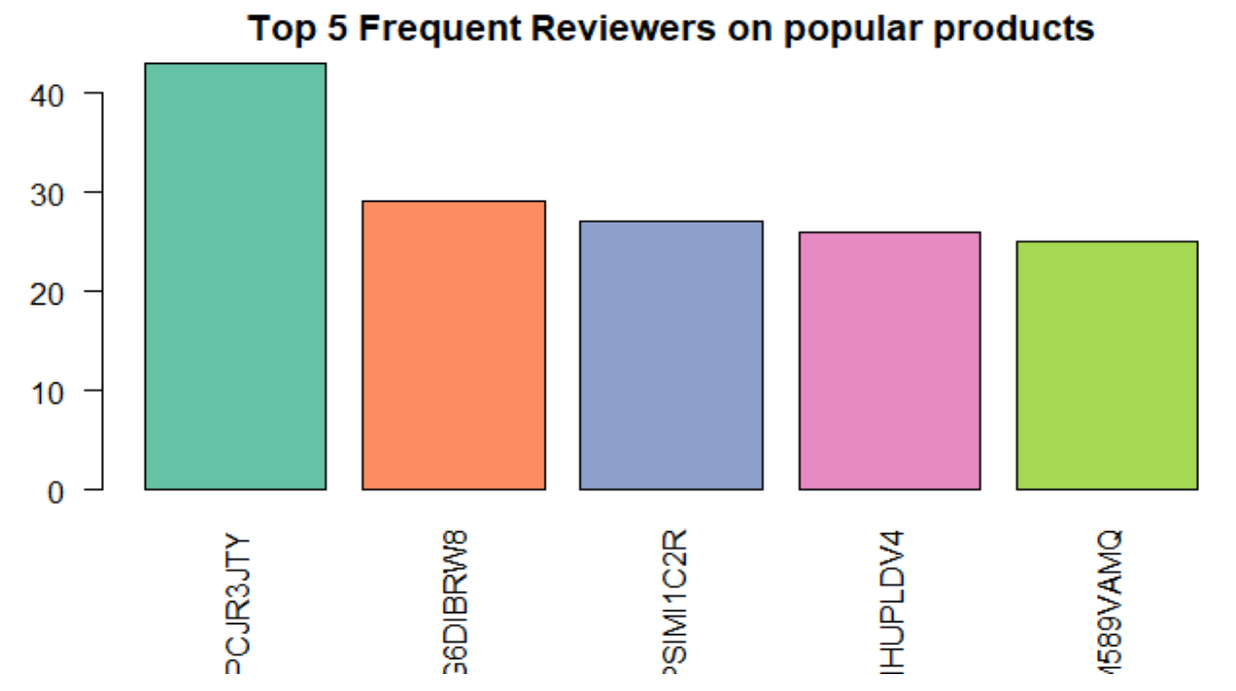
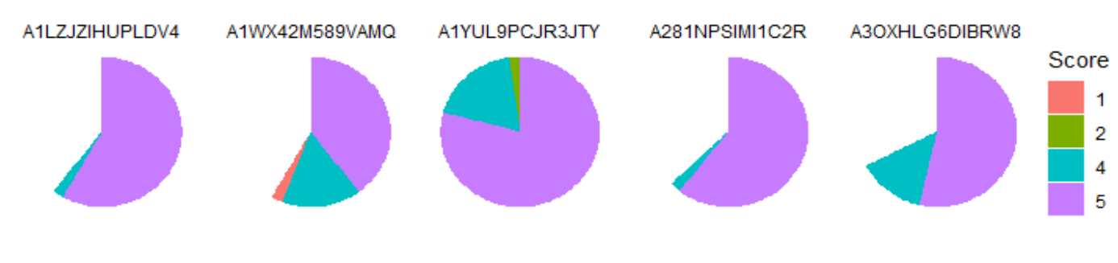
03
DATA ANALYSIS
Exploratory data analysis
First, we observe the top 5 customers providing high number of reviews
It would be interesting to see the distribution of rating that these top reviewers provide
Seeing the above plot, we can say that frequent reviewers are usually providing good score rating (5 & 4) and there are hardly any negative ratings provided by these customers. Using this information company can encourage these frequent reviewers to reviewer more items which would ultimately enhance the brand value.

Slide 8
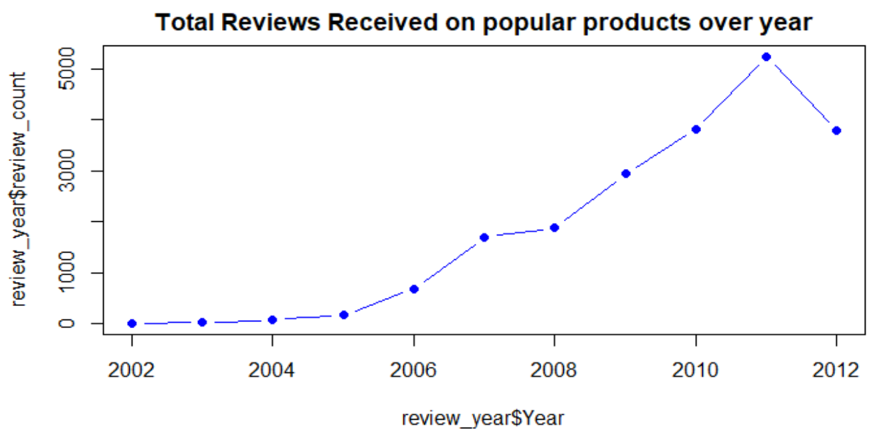
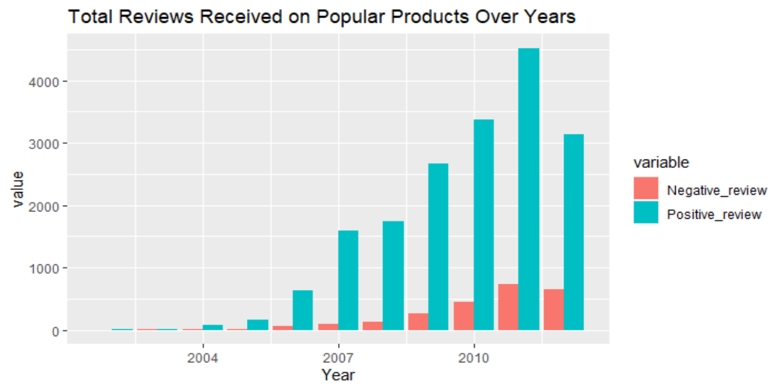
03
DATA ANALYSIS
Exploratory data analysis
Next, we analyze the number of reviews received from 2002 to 2012
We can see that there has been an incremental growth in the number products receiving greater than 3 reviews each year however there is a slight decrease from 2011 to 2012 which is indicating that there might be increase in number of reviews but a slight decrease in popular product reviews.
We can see that over the years there has been increase in positive as well as negative corresponding to the total number of reviews on popular products.

Slide 9
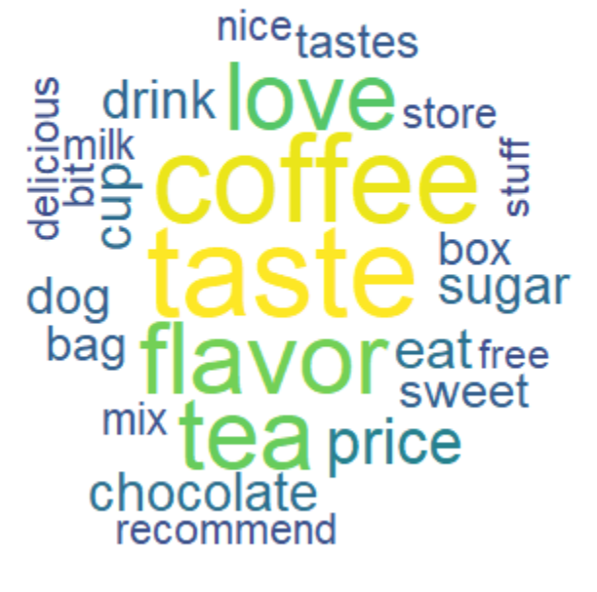
03
DATA ANALYSIS
Exploratory data analysis
looks like tea & Coffee are popular product which is greatly reviewed by people
There are few key words like "delicious" & "love" indicates that overall positive sentiment of customers
The use of words like "price", "taste" and "flavor" intuitively tells that the value of a product and products taste as well as flavor influences customer's sentiment

Slide 10
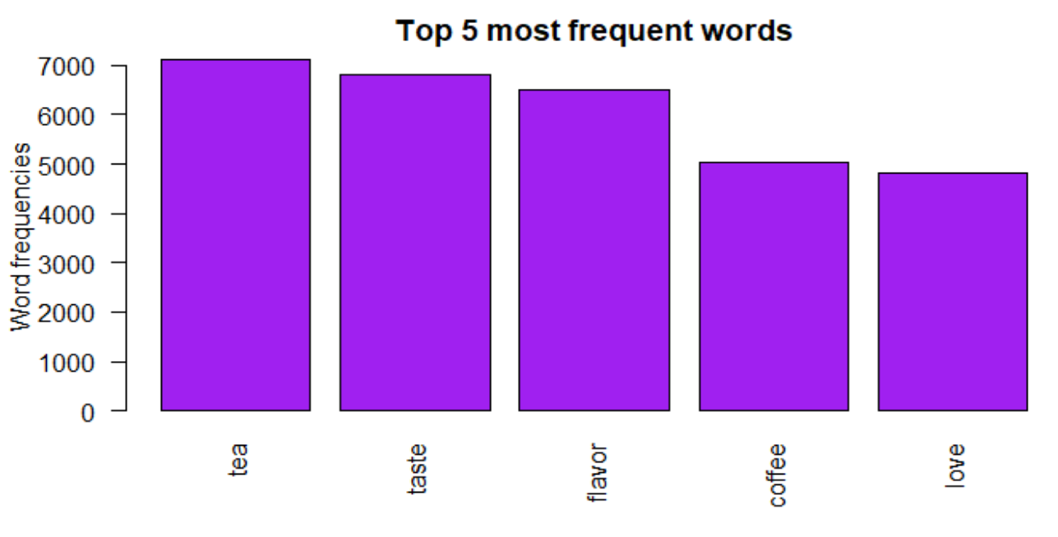
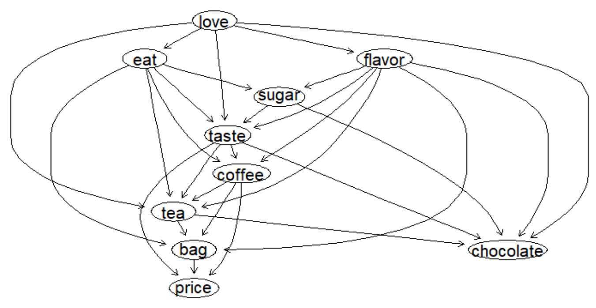
03
DATA ANALYSIS
Exploratory data analysis
Seeing the above bar plot we can say that beverages like tea and coffee are most reviewed products as the frequency of these terms is high. Also, words like "love" appear more in the reviews indicating that most of the reviews would be positive.
This Bayesian network is complex but one key deduction we can make from the network is that the conditional probability of the word "tea" appearing in the documents is dependent on the word's "love", "taste" and "flavor" appearing in the document. This means that the product tea is associated with a positive sentiment word of love.

Slide 11
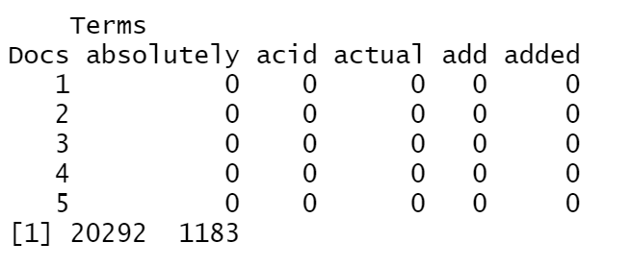
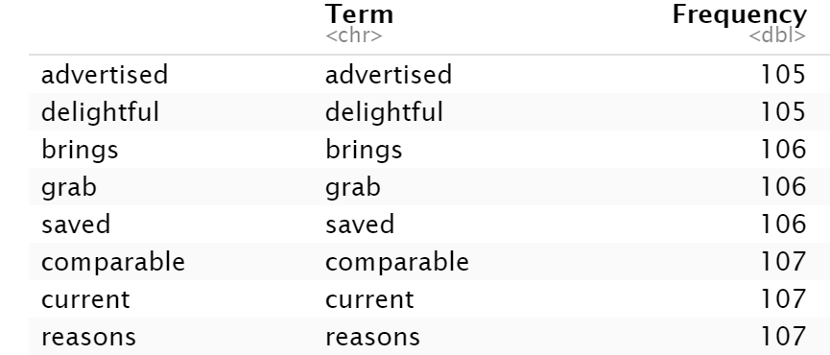
04
DATA PREPROCESSING
As part of data preprocessing to make it useful for text analysis below steps were followed:
Removed tags, URLs and emails
Remove white space
Removed numbers and punctuations
Removed stop words, smart words and top 200 most common words
Removed uninformative words

Slide 12
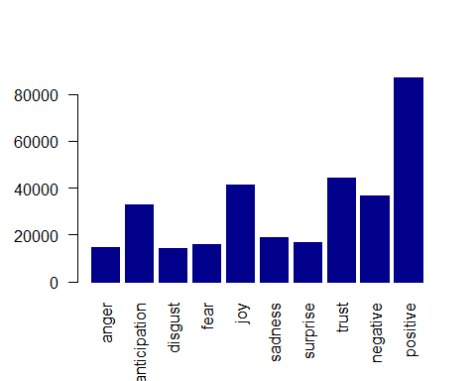
05
MODEL BUILDING
Using sentiment lexicon for sentiment analysis
From the plot showing frequency of each sentiment, we can say that most of the reviews are positive followed by trust and joy. There are less negative sentiment in customer reviews when compared to the positive reviews.
Also, the prevalence of anger, disgust, fear, sadness and surprise sentiments which is a good sign for overall foods that are sold on amazon website.

Slide 13
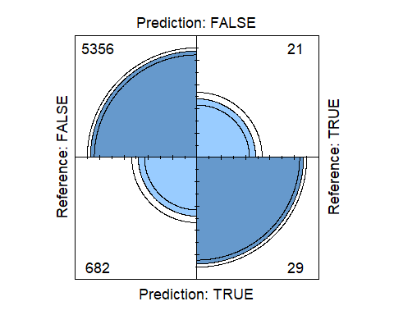
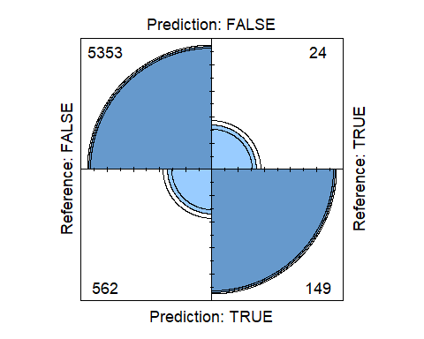
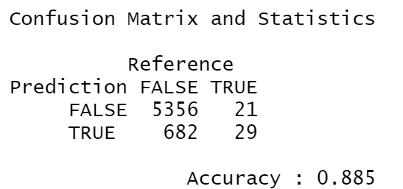
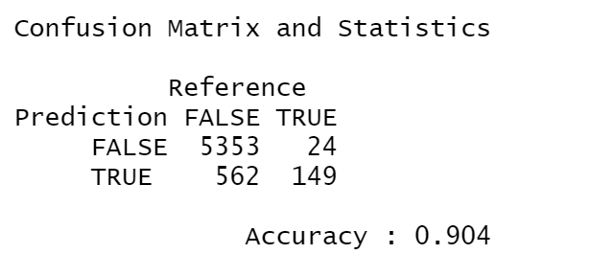
05
MODEL BUILDING
Using supervised ML models
Recursive Partitioning and Regression Trees Model
Support Vector Machine Model

Slide 14
06
CONCLUSION
Through the analysis done in this project we were able make below deductions:
The overall sentiment of customers reviewing popular food products is positive
Using the supervised ML model built in this project we can predict the positive and negative sentiment of customer with an accuracy of 0.9
Overall, the Frequent reviewers provide positive reviews and can be targeted to make them review more products that can enhance brand value
Products like tea and coffee are highly reviewed and usually there is positive sentiment associated with them
Taste, flavor and price are some of the influencing factors that were observed in customer reviews

Slide 15

THANK YOU

